Slide 1
Iran Automotive Industry: Opportunities and Challenges
5th Korea –Iran Cooperation Forum
Sep,2017
Seoul
Masood Kamali Ardakani
Director General of Industrial Export Bureau,
Iran Trade Promotion Organization
Former commercial counselor of Iran in China

Slide 2
1. Economic Position

Slide 3
The Automotive Industry
contributes to 11.8 % of the total value added in the industrial sector; (2011)
provides job for 10 % of industrial labor force, ranking as the 3rd job generating industry;(2013)
Automotive is the Iran’s second most developed industry, approx. 3% of the GDP
Within 2025 the GDP share is expected to increase to 4%

Slide 4
Strong Backward linkages
Iran’s auto industry has strong backward linkages with the other economic sectors. It is ranked as the 2th industry in terms of backward linkages (out of 23 manufacturing industries).
The automotive industry can be regarded as one of the key industrial growth movers in Iran

Slide 5
Production of Iran’s Auto Industry (1000 Units)
Source: Ministry of Industry, Mines and trade
Economic Sanctions had a serious effect on automotive industry, especially at the time when the industry was ready for major expansion. Before economic sanctions were imposed, Iran was the largest car producer in the Middle East

Slide 6
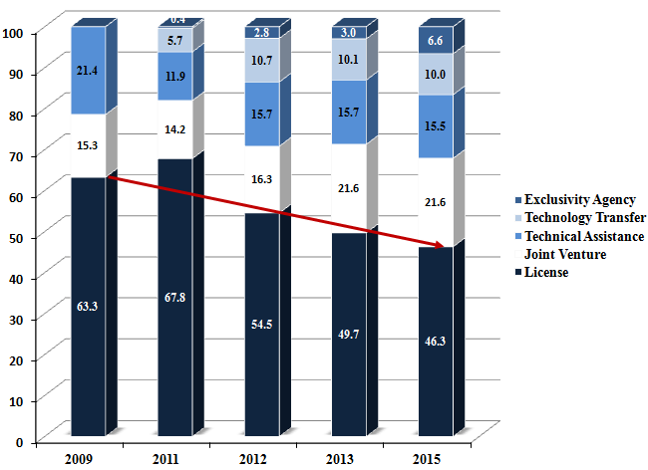
International Cooperation in auto parts
Source: http://www.iapma.ir/
Increasing share of joint venture and technology transfers has resulted in the improvement of local content

Slide 7
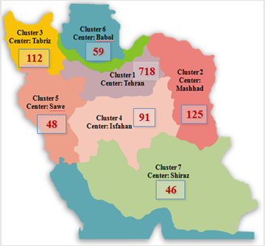
Auto Part Production in Iran
Dispersion of auto part clusters
Number of auto part manufacturers in supply chain: 1200
Number of Clusters: 7
Working Capital: 4.5 billion $
Sales (2015): 7 billion $
Share of industrial value added: 9%
Investment: 3 billion $
Source: http://www.iapma.ir/

Slide 8
2. Market Structure

Slide 9
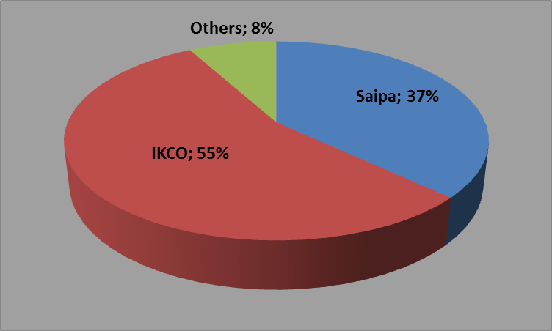
Market Structure for Passenger Cars (2015)
Regarding passenger cars, there are 6 auto maker companies, 2 of which account for 92 percent share of the auto market.

Slide 10
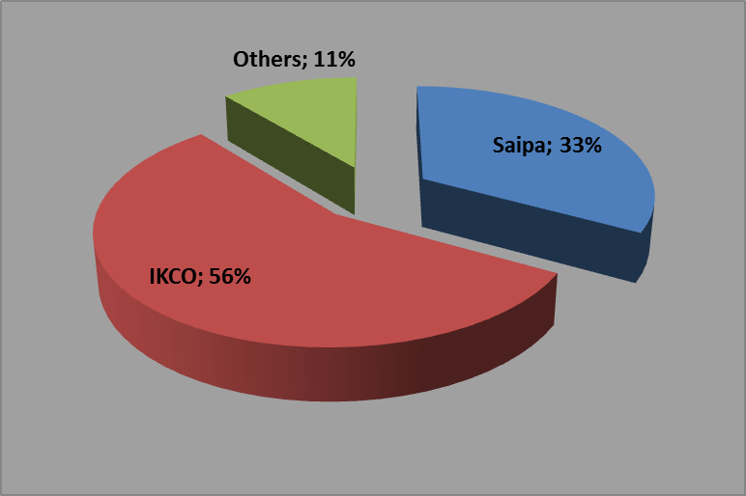
Market Structure for Commercial Vehicles (2015)
Iran Khodro Disel, Saipa Disel account for 89 percent the total domestic production in commercial vehicles and the remaining 11 percent is belong to 13 companies

Slide 11
International Cooperation in auto parts
Source: http://www.iapma.ir/
Increasing share of joint venture and technology transfers has resulted in the improvement of local content

Slide 12
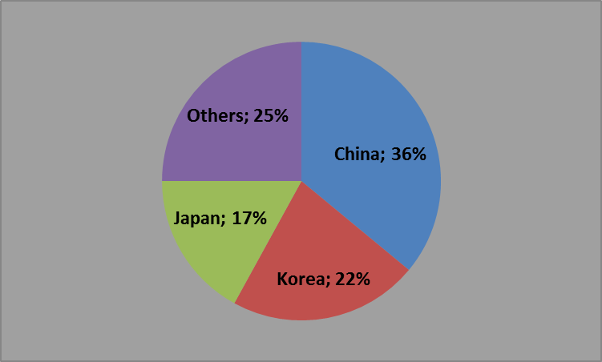
International Cooperation in automotive (2015)
Combination of License contracts:
Passenger cars
Source: Ministry of industry, mine and trade
China ranks 1st as Iran’s most important partner. It contributes to 36 percent license contracts in Iran with a local content ranging between 14-26 percent.
Korea has the owns second largest share in Iran's international license contracts (26 percent) with the local content ranging between 14-87%.

Slide 13
Iran’s International Cooperation in Auto Industry
Products | Year of contracting | Type of cooperation | Foreign Partner
various types of auto parts including 405, 206 and Samand | 2004 | product sharing contract, 51% | France (Valeo)
Production of Mercedes-Benz trucks with Iran Khodro Diesel and Mammut Group | 2016 | Joint Venture | Germany (Daimler)
production of 208, 301 and 2008 models, with an annual production capacity of 100,000 units with IKCO 30% of production will be export | 2016 | Joint Venture | France (Peugeot)
development of a modular automotive platform, able to underpin at least four different vehicles including a medium segment passenger car | 2017 | Joint Venture | Italy (Pininfarina)
to design and manufacture a turbo straight-three engine to reduce the technological gap between Iran’s automotive industry and its counterparts. | 2017 | Joint Venture | Germany (Mahle)

Slide 14
Joint ventures and partnerships are the most popular go-to-market strategies used by major players in Iran’s auto industry.
We are Looking for win – win cooperation framework, while the limitations ( such as banning the importation of foreign cars as well as KOMEHO tire) on foreign trade shows the new approach of the government.

Slide 15
IRAN Investment Policies and requirements for foreign auto makers
40% Local Content Requirement at the first year of the production,
Export of at least 30% of the production to the foreign markets,
Know how transfer as well as establishing R&D Center required.

Slide 16
3. Opportunities and Challenges:
of IRAN auto industry

Slide 17
3. Opportunities
The strategic goals set for automotive industry in horizon 2025
To produce at least 3 million units, 2 million for domestic market and 1 million for export;
To produce at least 50% of light vehicles with local brands;
To have at least $25 bn worth of parts and components for domestic cars supplied by local producers;
To have at least $6 bn worth of auto parts and components (production lines and parts) exported by local producers
To produce at least 120000 commercial vehicles, 90000 for domestic market and 30000 for export

Slide 18
3. Opportunities (cont)
Market Potentials and Proximity:
Vast domestic market with a population of 78.1 Million growing steadily as well as quick access to neighboring markets with approximately 300 million inhabitants.
Foreign brands continue to show interest in local sales and/or production, with Daimler, VW, Skoda, Fiat and Peugeot among the brands reportedly in talks to enter the market.
Low base effects, pent up demand, and consumer preferences for foreign brands will drive growth in the automotive market.

Slide 19
3. Opportunities (cont)
Using old platform and being ready to use new platforms in order to manufacture modern autos according to costumer taste
Availability of required conditions for entrance of Non Chinese companies in post-sanction period to supply original parts. Under sanctions autos imported as CKD or domestic cars produced by using Chinese parts.
Higher custom duties on CBU and thus increase in final cost that leads to increase in tendency for CKD import and CKD parts

Slide 20
3. Challenges
large number of auto part manufacturer without economic scale and access to tier1.
Concentrated market structure for automotive market
Complicated Private – Public Structures in many companies (for example 80 percent of Iran khodro’s stocks belongs to 14 companies with private – public stockholders).
Price regulation made by competition council

Slide 21
4. Iran and Korea bilateral trade and economic relations
in auto industry

Slide 22
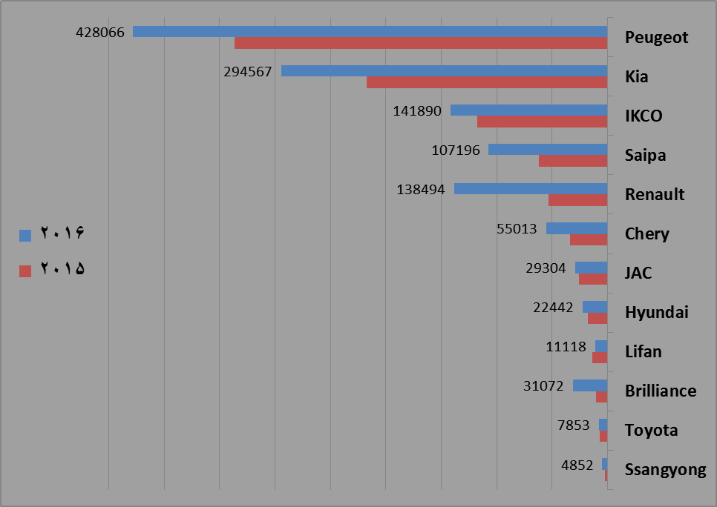
Korean Brands Auto Sales in Iran Market 2015-2016
Source: Ministry of industry, mine and trade
Korean Brands market sales increased 35% in 2016 near to 320 thousands automobile

Slide 23
In 2016, around 46 % of imported cars was belong to Korean brands
Market share(%) | Auto importation(unit) | Company name
28.4 | 17398 | Hyundai
18.16 | 11096 | Kia
46.2 | 28494 | total
Production (unit) | Local partner | Auto Brand | Company name
198 | Kerman khodro | i10 | Hyundai
835 | Kerman khodro | i20 | Hyundai
13197 | Saipa | Cerato | kia
Korean brands production inside Iran are less than 1% of total auto production

Slide 24
Ongoing cooperation of Korean and Iranian companies in auto and auto part section
Field of cooperation | Iranian company | Korean company
Gear Box instalment | Iran Khodro | Hyundai Power Tech & LGE Co.
fuel consumption Optimizing | Iran Khodro | Tenergy
Joint production of CV Under negotiation | Ministry of industry, mine and trade | Hyundai
Electrical cars and related equipment's such as battery | IDRO | LGI

Slide 25
Priorities of cooperation with Foreign auto makers
Balanced development of automotive industry value chains from auto part production to after sale services,
Enhanced cooperation with leading global companies in the form of joint venture (not just license) and emphasis on export,
Finally, Enhanced outward orientation in auto industry and its participation in Global Value Chains (GVC’s).
increase depth of local content. local content requirements in new joint venture contract increase to 40%

Slide 26
With Many Thanks
mkamali1@yahoo.com

